Slide 1





Remote Sensing of Woody Vegetation in the West African Sahel
Presented By: Andrew Wickhorst
Space Grant Mentor: Dr. Stefanie Herrmann
Space Grant Symposium
University of Arizona
April 21, 2012

Slide 2
Why is it Important to Map Woody Cover?
Important for understanding the carbon balance
Trees are of great importance to the Sahelian agricultural parklands
Monitoring changes in vegetation composition over time.
Notes:
Which in turn helps us to understand the mechanisms of climate change
For fuel, shade, windbreaks, soil erosion, fertility, and structure, food source.
Drought monitoring and deforestation

Slide 3
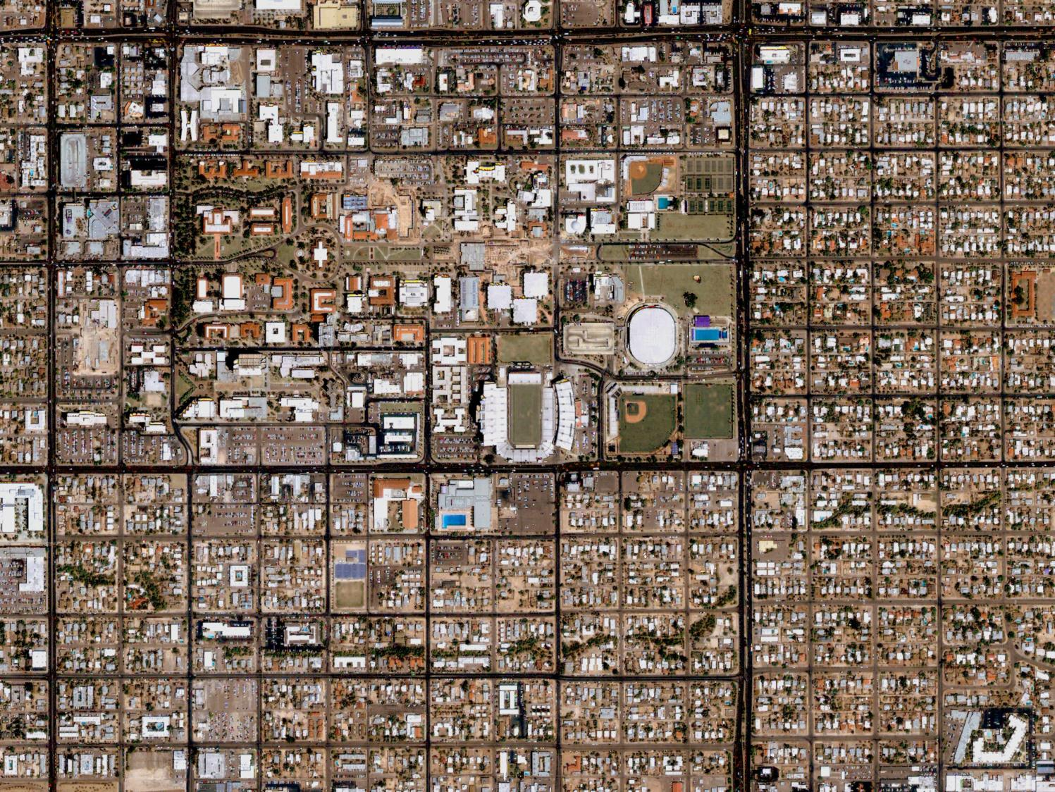
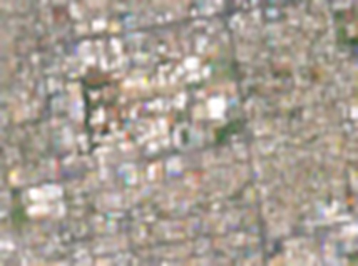

What is Spatial Resolution?
High
Low
Notes:
University of Arizona Campus
4m spatial resolution
30m spatial resolution
1km spatial resolution

Slide 4
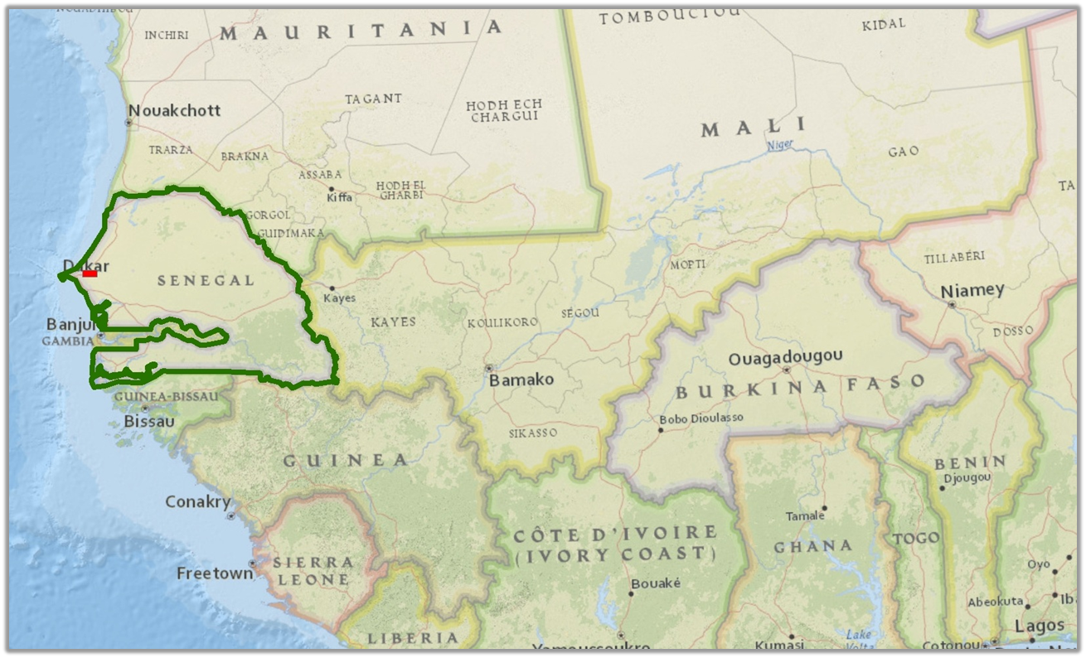
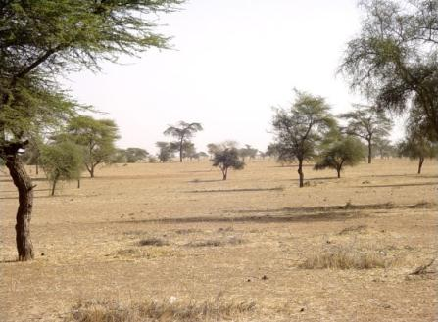
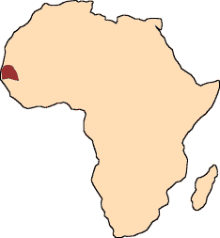
Study Area: Senegal
http://cache.virtualtourist.com/4/3299027-_Senegal.jpg
Notes:
red rectangle = study area
The image is an example of the typical vegetation encountered in the Sahelian landscape.
The location of our study area is known as the “Thiès Region of the Old Peanut Basin.”
Sahel is a semi-arid transition zone (grasslands, savannas)

Slide 5
Objectives
Create an accurate map of tree densities within the study area using very high spatial resolution (2m) imagery.
Determine the optimal model for estimating tree cover densities in a Sahelian landscape using coarser spatial resolution (30m) imagery.

Slide 6
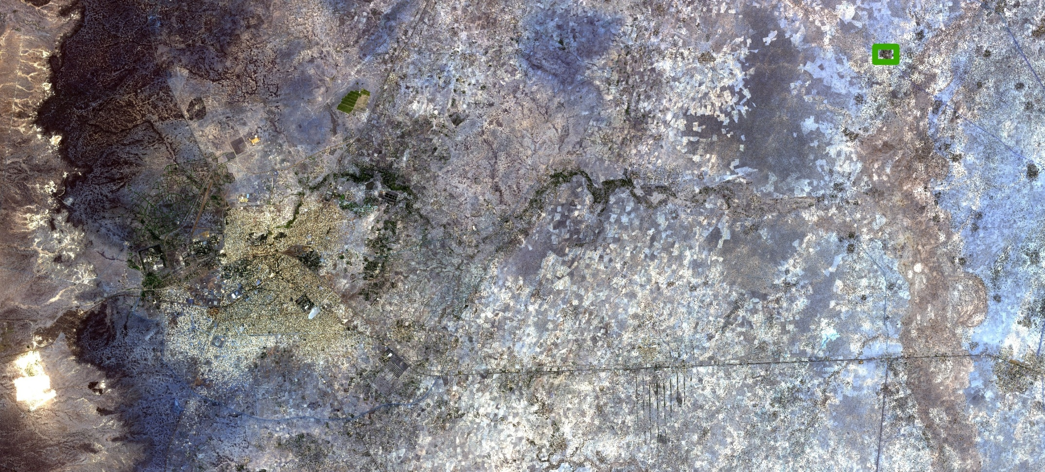
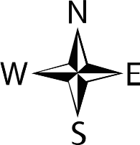
Very High Spatial Resolution (OrbView, 2m)
0
2
4
8
12
16
Kilometers
Notes:
To orient audience, point out the river, roads, city, village (highlighted with green square)
Area = 580 km^2

Slide 7
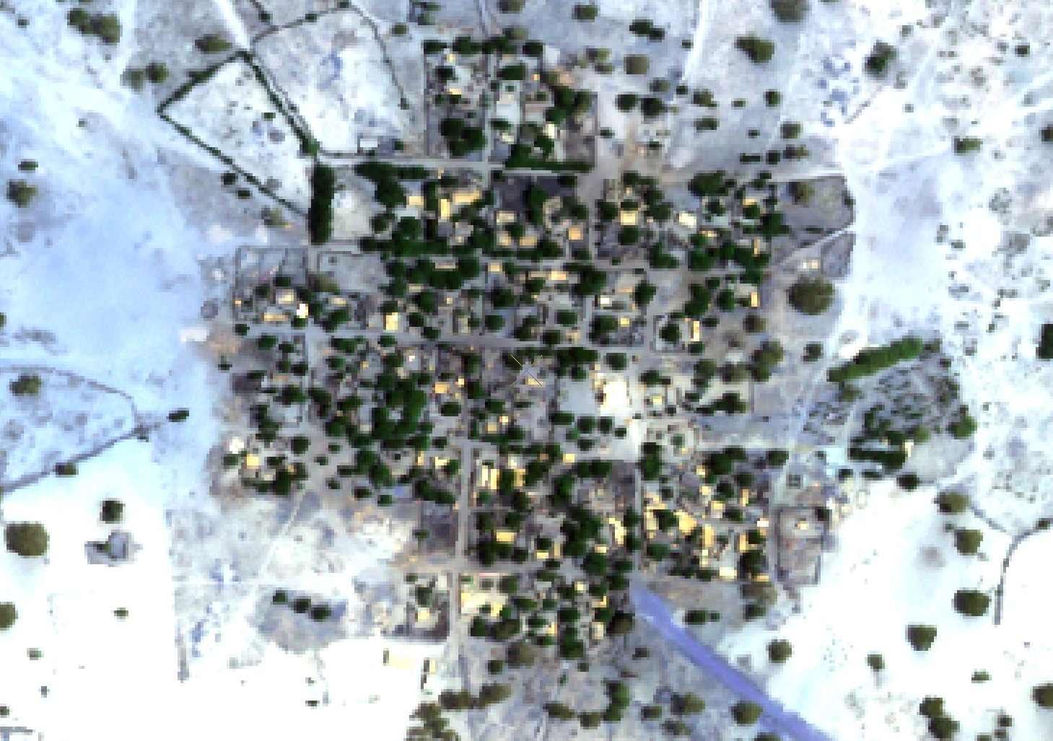
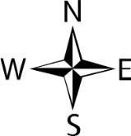
Very High Spatial Resolution (OrbView, 2m)
0
0.05
0.1
0.2
0.3
0.4
Kilometers
Notes:
Area = 7 km^2
Small villages with homes and trees

Slide 8
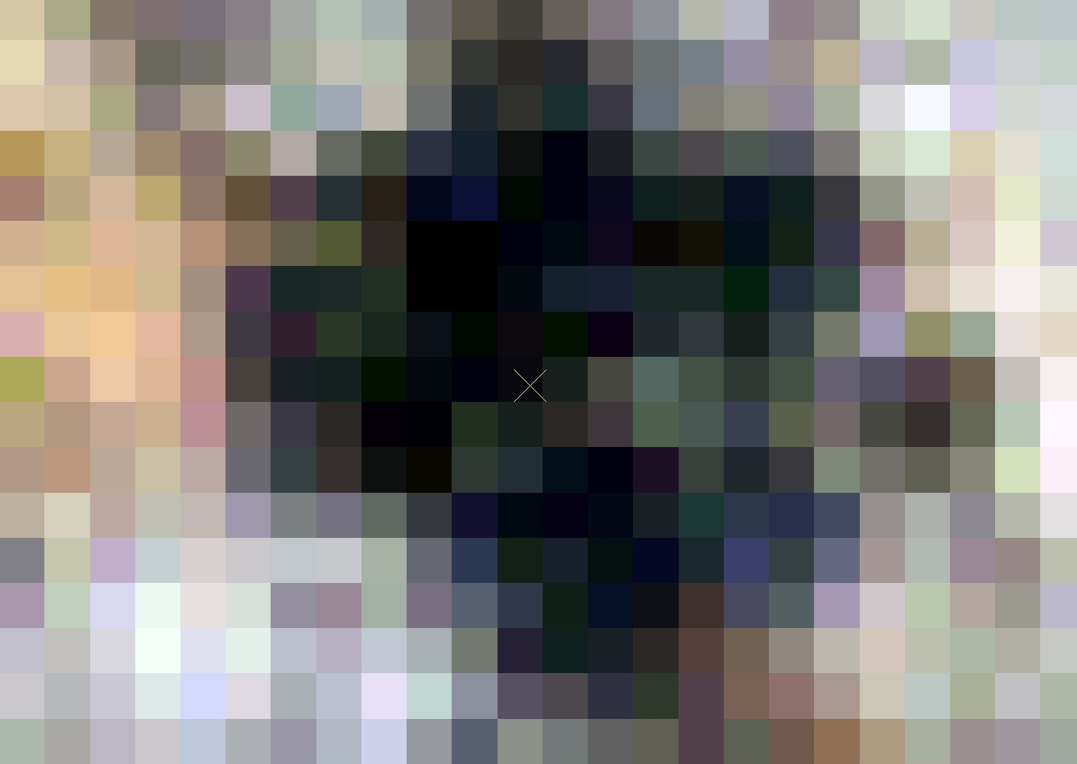
Coarser Resolution (Landsat, 30m)
0
0.05
0.1
0.2
0.3
0.4
Kilometers
Notes:
Area = 7 km^2
(Emphasize resolution differences at this point when comparing to OrbView)
As can be seen, buildings and trees cannot be distinguished at this resolution.

Slide 9
Spatial Resolution & Tree Cover Mapping
High spatial resolution imagery
  Individual trees can be detected
  Not available for all locations
  Often prohibitively expensive
  Limited historical data
Coarser spatial resolution imagery
  Individual trees cannot be detected
  Global coverage
  Free
  Many years of historical data
Notes:
High resolution = 2m OrbView
“Coarser” resolution = 30m Landsat
This slide compares the two different resolutions and how they apply for tree cover mapping.

Slide 10
Methods
Obtain and pre-process imagery
Create reference map of tree densities from high spatial resolution imagery.
Produce and test predictive models of tree densities based on coarse spatial resolution imagery
Select “best” model and assess performance

Slide 11

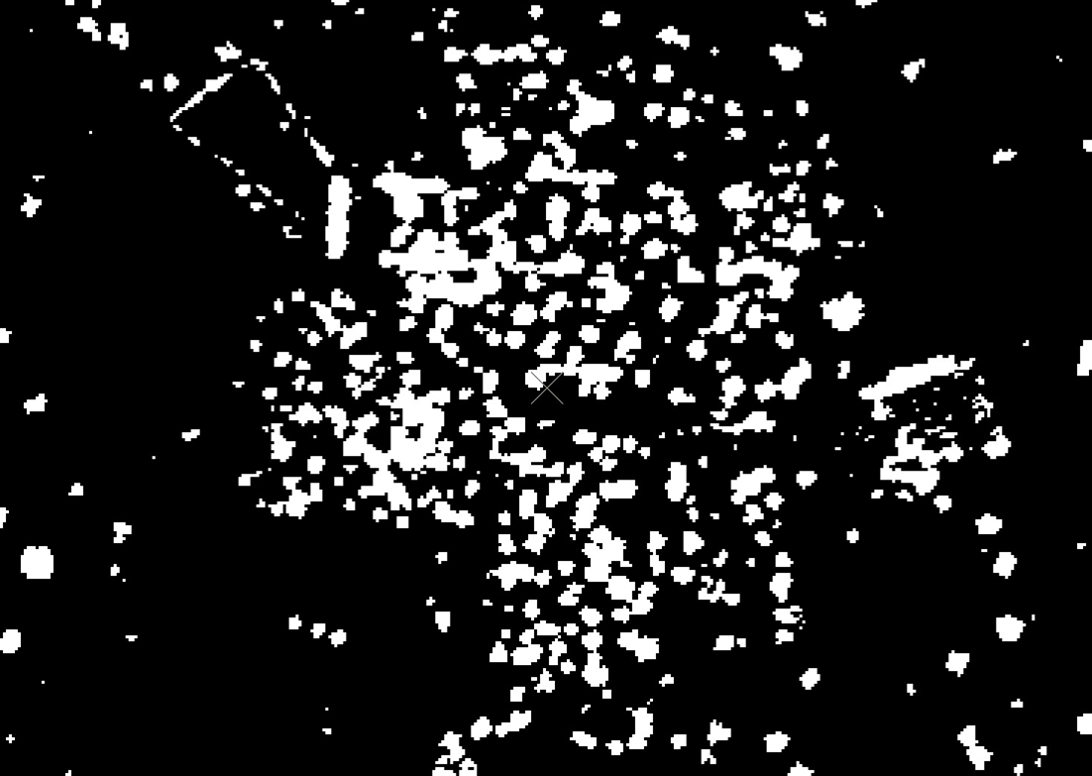
Tree vs. No Tree
0
0.05
0.1
0.2
0.3
0.4
Kilometers
Tree
95 % Accurate
No Tree
Notes:
The binary surface was determined to be 95% accurate and was used as the basis for the reference map.
(Don’t mention NDVI, just say tree cover was “extracted” from the high resolution data.)
This process was performed for the entire study area.

Slide 12
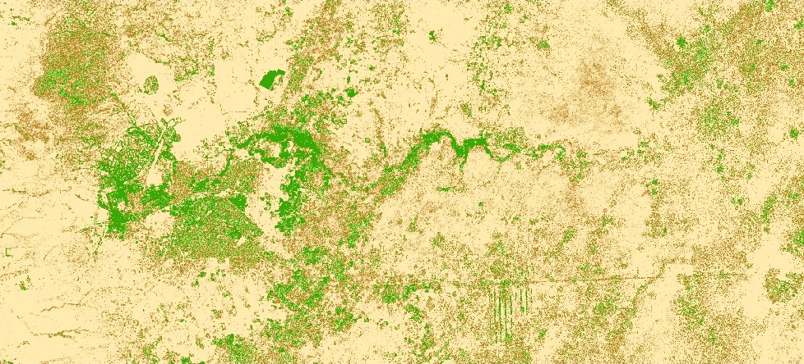
Reference Map
0
2
4
8
12
16
Tree Cover Density
Kilometers
100 %
50 %
0 %
Notes:
Aggregation of OrbView binary surface to 30m. Each pixel has a value from 0 to 100, indicating percent tree cover. The original binary surface was 95% accurate, therefore this aggregate is also 95% accurate.

Slide 13
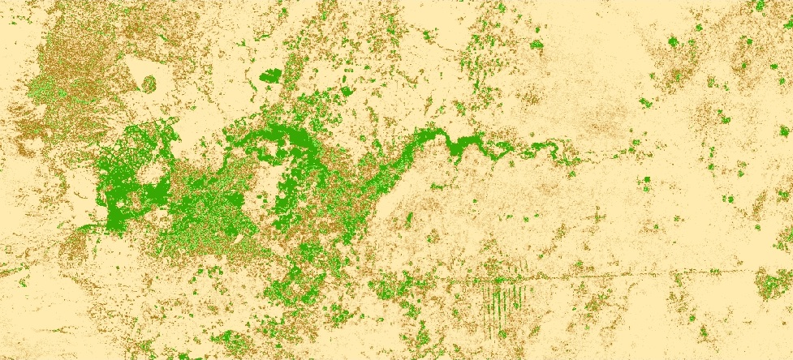
Predictive Model of Tree Cover
0
2
4
8
12
16
Tree Cover Density
Kilometers
100 %
50 %
0 %
Notes:
Cubist uses a regression tree approach to build rule-based predictive models that are used to estimate continuous variables, in this case percent tree cover.

Slide 14
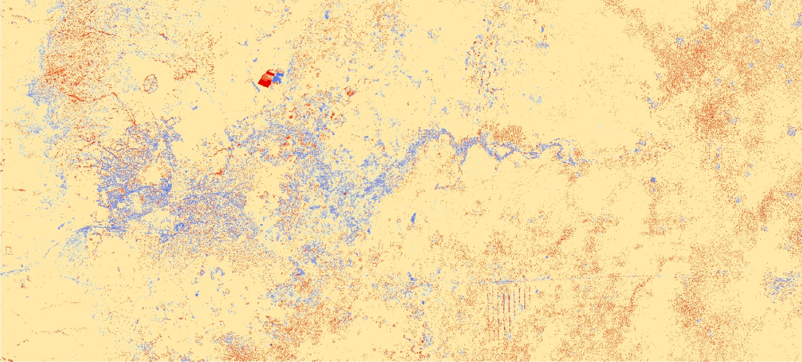
Model-Reference Comparison
0
2
4
8
12
16
Over Predicted
Kilometers
Correctly Predicted
Under Predicted
Notes:
This image shows the locations where Cubist under and over predicted the density of tree cover. The areas that stand out in particular are the riparian and agricultural regions.
(Highlight the field which was harvested).

Slide 15
Correlation of Actual & Predicted Tree Cover
R² = 0.79
SE = 3.6 %
Notes:
This scatterplot is a comparison of actual and predicted % tree cover densities from a sample of 500 random points (10,000 points were used to create the predicted surface)
Because this is an arid region, the majority of pixels have less than 20 % tree cover.

Slide 16
Conclusion
Coarser resolution imagery is a viable alternative to high resolution imagery for the estimation of tree cover
The resulting model replicates the spatial pattern of tree cover well
A standard error of 3.6% tree cover indicates a relatively accurate estimation
However, the interpretation of the standard error also depends on the overall percent tree cover
Notes:
Last bullet point: Most locations have a tree cover density of less than 10%
3.6% is fairly high error for the lower density pixels
“After all, if we can use high resolution imagery to come up with a way to predict tree cover density using coarse resolution imagery, then we can go from an costly solution to a free solution.”

Slide 17
Acknowledgements
University of Arizona Space Grant Consortium
Arizona Remote Sensing Center
Office of Arid Land Studies
United States Geological Survey (USGS)
Stefanie Herrmann, PhD
Stuart Marsh, PhD
Willem van Leeuwen, PhD
Barron Orr, PhD
Kyle Hartfield, MS
Abd salam El Vilaly, MS
Katy Landau
Denise Garcia

Slide 18
Thank You!

